Slide 1
Everything Plus Customer Analysis
24/03/2024
Source: ecommerce_dataset_us.csv

Slide 2
Objectives
Understand what kind of customer we have and the quantity for each segment.
Identify sales seasonality, popular products and order volumes per segment.
Identify patterns in sales.
Identify high volume and high revenue products.
Understand sales through time period.
From customer segmentation define what approach should be taken for each segment to increase revenue.

Slide 3
KPI’S
Order Value – Monetary
Quantity – Volume
Date - Frequency, recency
Total Sales – Revenue

Slide 4
General Analysis

Slide 5
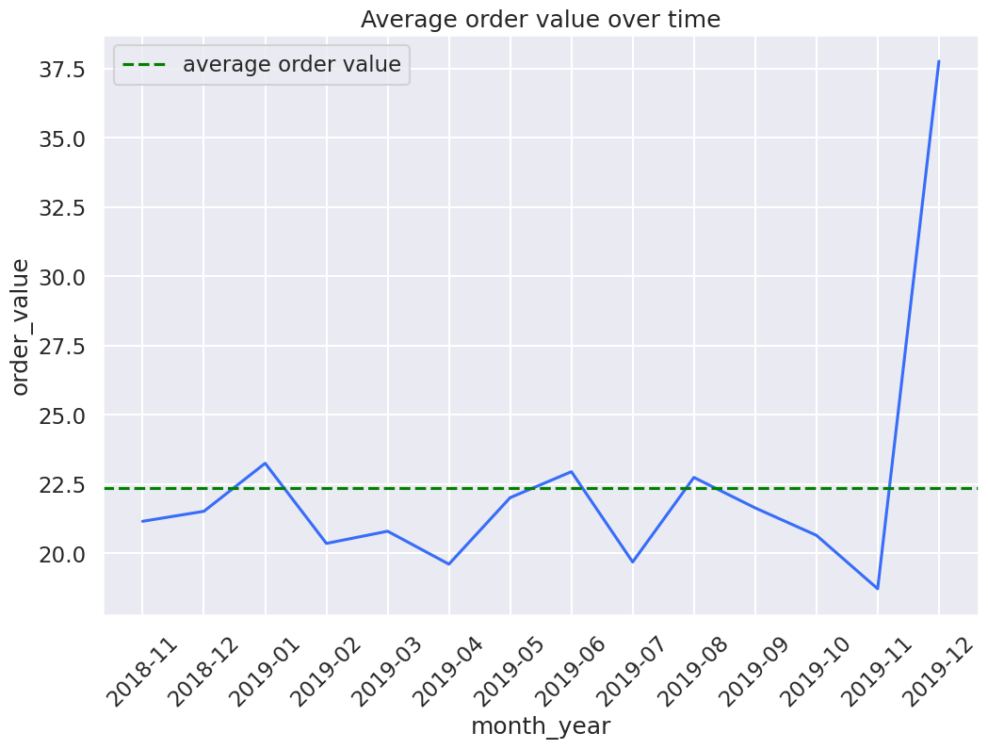
Average Order Value
month_year | order_value
2018-11 | 21.15
2018-12 | 21.52
2019-01 | 23.25
2019-02 | 20.36
2019-03 | 20.80
2019-04 | 19.61
2019-05 | 22.01
2019-06 | 22.95
2019-07 | 19.68
2019-08 | 22.74
2019-09 | 21.64
2019-10 | 20.65
2019-11 | 18.72
2019-12 | 37.77
Average order value is $22.34.
The order value is higher than its average in four different periods: Jan/2019, Jun/2019, Aug/2019 and Dec/2019.
The Highest point is Dec/2019 and the lowest Nov/2019.

Slide 6
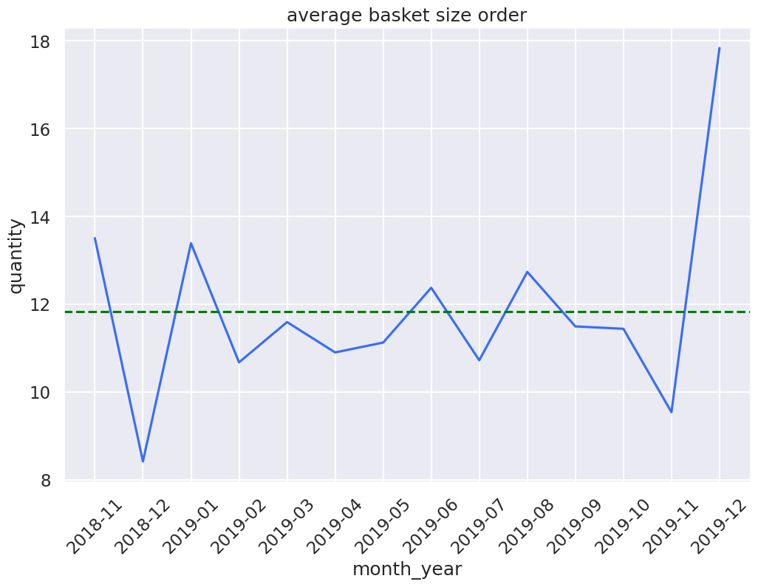
Average Basket Size
Average basket size is 11.83.
Highest average is Dec/2019, indicating increase volume and revenue for this period.
Lowest in Dec/2018 indicating customers bought products from a higher price category.
month_year | quantity
2018-11 | 13.50
2018-12 | 8.42
2019-01 | 13.39
2019-02 | 10.68
2019-03 | 11.59
2019-04 | 10.90
2019-05 | 11.13
2019-06 | 12.37
2019-07 | 10.72
2019-08 | 12.74
2019-09 | 11.49
2019-10 | 11.44
2019-11 | 9.54
2019-12 | 17.84

Slide 7
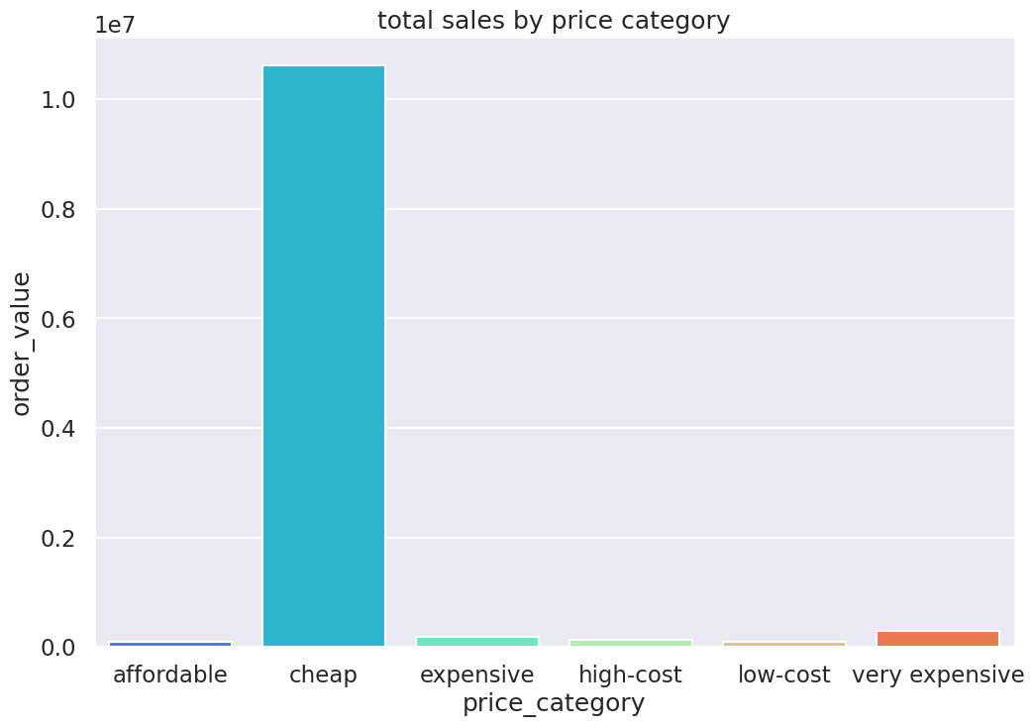
Price Category Revenue Percentage
price_category | percentage
cheap | 93.17
very expensive | 2.55
expensive | 1.58
high-cost | 1.11
low-cost | 0.86
affordable | 0.74
The price categories were set as:
Cheap anything less or equal to 50
Low-cost between 51 and 200
Affordable between 201 and 500
High-cost between 501 and 1000
Expensive between 1001 and 5000
Very expensive above 5001

Slide 8
Data Discrepancies
1. Adjusted bad debt
3 transactions of 'ADJUSTED BAD DEBT ' were found, all 3 with the same amount within 1 minute difference between them.
The amount was 11062.06
Was this customer refunded 3 times by mistake ?
2. Manual
Product described as 'Manual' found during data analysis
Are this 'manual' transactions or it is actually a product ?
3. Amazon Fee
5 transactions in total were found under the 'Amazon Fee description' total of 249,042.68 and one of them using a different stock code from the others.
Further investigation of values and procedures as suggestion.

Slide 9
Customer Segmentation Analysis

Slide 10
Customer Segmentation
RFM method based on customer scores was used on this analysis.
Recency: Recency refers to how recent a customer's last purchase was. Customers who have made a recent purchase, still have the product and brand on their minds and are most likely to make a repeat purchase.
Frequency: Frequency is how often the customer makes purchases, which can help you identify repeat customers.
Monetary value: Monetary value refers to how much a customer spends within a given period.
We divide customers in 6 categories: Best Customers, Loyal Customers, Big Spenders, Almost Lost Customers, Lost Customers and Lost Cheap Customers

Slide 11
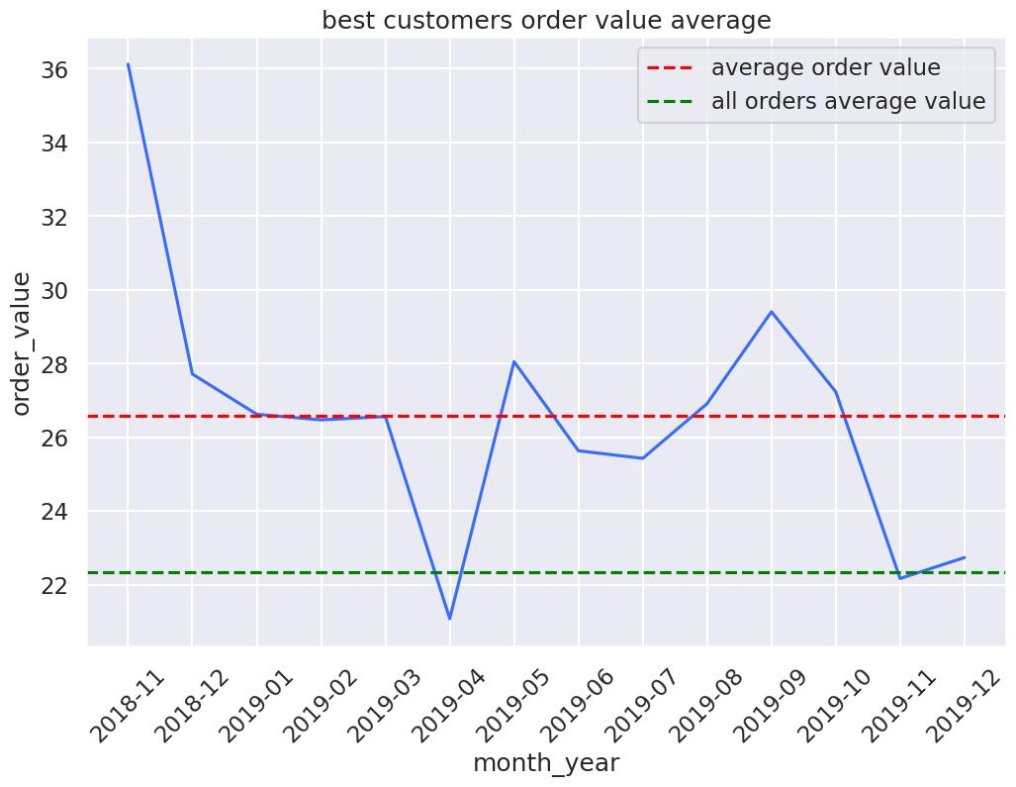
Best Customers
month_year | order_value
2018-11 | 36.11
2018-12 | 27.71
2019-01 | 26.62
2019-02 | 26.47
2019-03 | 26.56
2019-04 | 21.08
2019-05 | 28.05
2019-06 | 25.63
2019-07 | 25.42
2019-08 | 26.91
2019-09 | 29.40
2019-10 | 27.23
2019-11 | 22.16
2019-12 | 22.73
Best customers total: 449, 14% of total customers.
The lowest point of those customers in April/2019.
Average Order over Christmas period 2019 not as high as 2018.
Average of this group higher than all customers average.
After peak in Nov/2018 the next peak is in September.

Slide 12
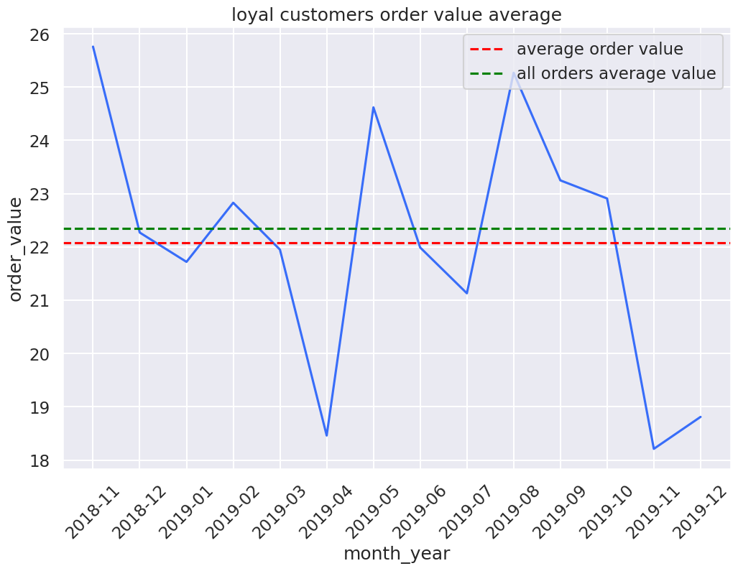
Loyal Customers
month_year | order_value
2018-11 | 25.76
2018-12 | 22.27
2019-01 | 21.72
2019-02 | 22.83
2019-03 | 21.95
2019-04 | 18.46
2019-05 | 24.62
2019-06 | 21.99
2019-07 | 21.13
2019-08 | 25.27
2019-09 | 23.25
2019-10 | 22.91
2019-11 | 18.21
2019-12 | 18.81
Loyal customers total: 1087, 34% of total customers.
The lowest point of this customers was April/2019
3 average peaks in Nov/2018, May/2019 and Aug/2019
Average on lowest point in Nov/2019 not showing good recovery in Dec/2019
Average of this group is similar with all customers average.

Slide 13
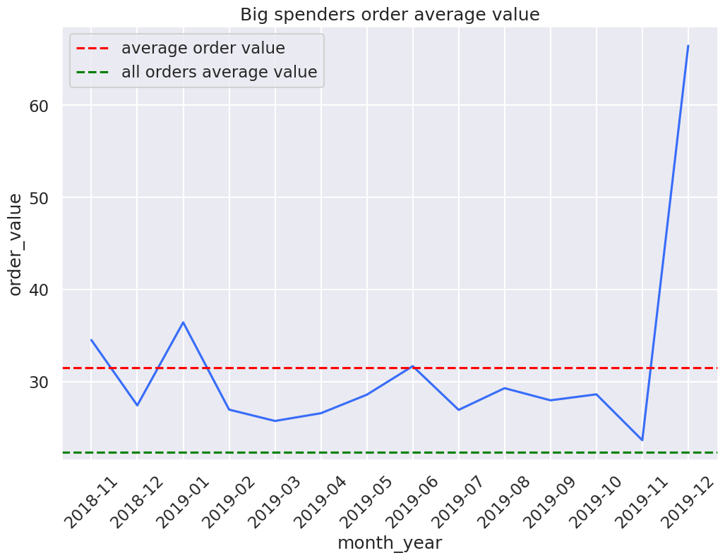
Big Spenders
month_year | order_value
2018-11 | 34.51
2018-12 | 27.42
2019-01 | 36.43
2019-02 | 26.96
2019-03 | 25.73
2019-04 | 26.57
2019-05 | 28.58
2019-06 | 31.68
2019-07 | 26.93
2019-08 | 29.29
2019-09 | 27.97
2019-10 | 28.62
2019-11 | 23.64
2019-12 | 66.46
Big spenders customers total: 1092, 34% of total customers.
Lowest point in Nov/2019.
Highest point in Dec/2019 indicating customer engagement over Christmas period.
Average of this group never dropped below all customer average.

Slide 14
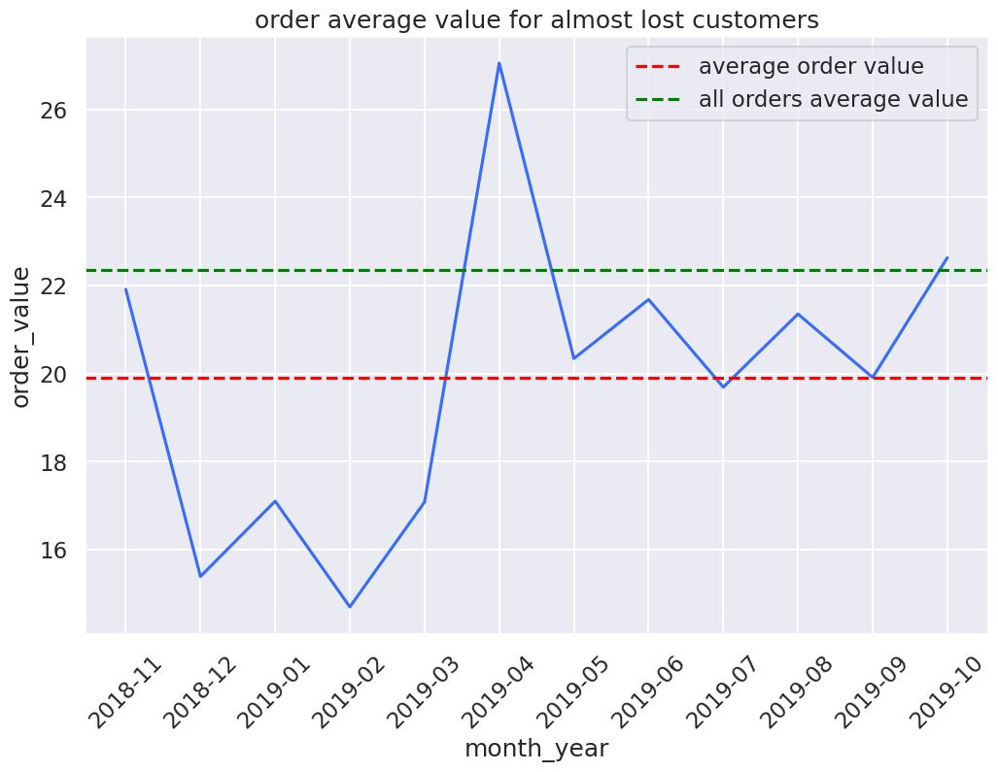
Almost Lost Customers
month_year | order_value
2018-11 | 21.91
2018-12 | 15.39
2019-01 | 17.10
2019-02 | 14.70
2019-03 | 17.08
2019-04 | 27.05
2019-05 | 20.34
2019-06 | 21.68
2019-07 | 19.69
2019-08 | 21.35
2019-09 | 19.91
2019-10 | 22.63
Almost lost customers total:101, 3% of total customers.
Lowest point in Feb/2019.
Highest point in April/2019.
Average under all customers average.
Records from this customers only until Oct/2019.

Slide 15
Lost Customers
month_year | order_value
2018-11 | 21.91
2018-12 | 15.39
2019-01 | 17.10
2019-02 | 14.70
2019-03 | 17.08
2019-04 | 27.05
2019-05 | 20.34
2019-06 | 21.68
2019-07 | 19.69
2019-08 | 21.35
2019-09 | 19.91
2019-10 | 22.63
Lost customers total: 25, 0.7% of total customers.
Highest point in April/2019.
Lowest point Feb/2019.
Order average stabilized after April/2019 indicating good customer experience after this period.
Oct/2019 average is above all customers average indicating customer potential.
Records of this customers stop in Oct/2019.

Slide 16
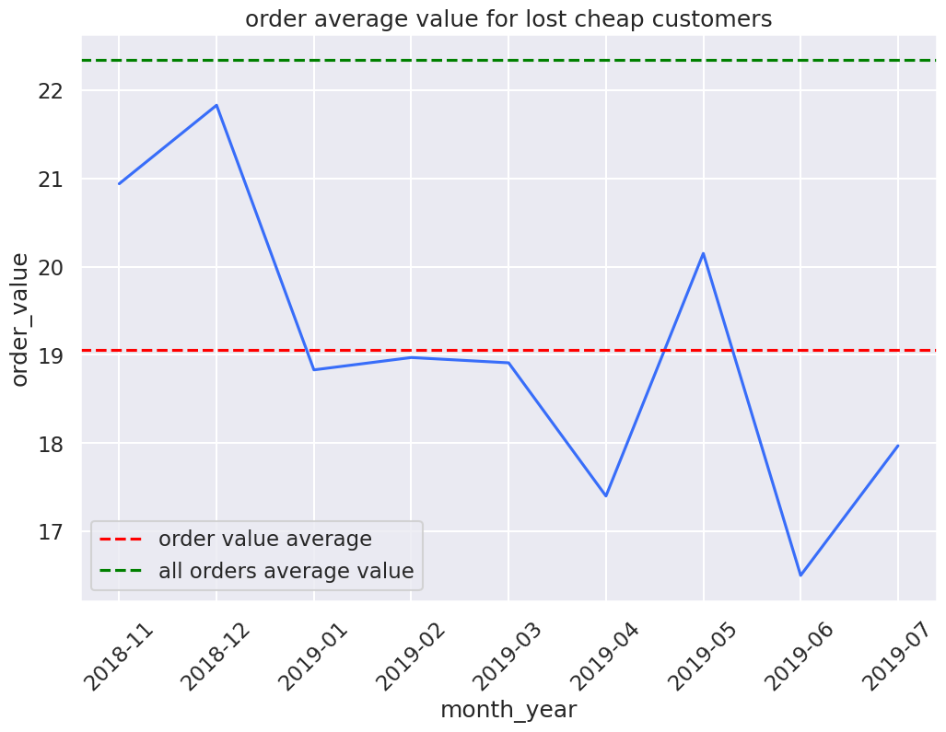
Lost Cheap Customers
Lost cheap customers total: 390, 12% of total customers.
Highest point in Dec/2018.
Lowest point Jun/2019.
There is peak in May/2019. After this peak and highest point sales dropped indicating possible bad customer experience.
Sales record of this group stop in Jul/2019
month_year | order_value
2018-11 | 20.94
2018-12 | 21.83
2019-01 | 18.83
2019-02 | 18.97
2019-03 | 18.91
2019-04 | 17.40
2019-05 | 20.15
2019-06 | 16.50
2019-07 | 17.97

Slide 17
Suggested Actions
1. Best Customers
Best customers were at the highest in November/2018, why the sales are not as high for 2019 data ?
Marketing and sales department should work close with this customers to create promotions, offer products, exclusive access to new launches to increase sales opportunity on seasonal period.
2. Loyal Customers
Suggest loyalty rewards, special promotions of expensive items as they figure 1.23% of sales, promotions and rewards to increase revenue of this segment.

Slide 18
Suggested Actions
3. Big spenders
Big spenders have their average sales and basket size in December/2019 on Christmas period but their lowest is just one month before.
Marketing and sales department should create opportunities to increase sales on the building months for this period.
Average basket size was highest of all, are this customers retailing products that they are supplied by us ? Bulk promotions offers could be created.

Slide 19
Suggested Actions
4. Almost lost customers
Special promotions of expensive items could be created to impulse sales from this segment. Of all segments expensive price category with higher percentage
What were the events in April/2019 that pushed their order values to a highest ? Easter ?
Implementation of process to collect as much feedback as possible to understand why the recency is low. From that work on solutions.
Focus on this segment could push them to best customers' segment.

Slide 20
Suggested Actions
5. Lost customers
This customers show their highest average on sales and basket size on December/2018, we suggest reach this customers to understand how was their experience on last Christmas.
The potential of expensive items is also there, should we create offers for them.
6. Lost cheap customers
Same as lost customers, data show their peak revenue in December/2018, we must understand their experience during that period.
Offers to increase basket size as this customers prefer cheap and low-cost items to try reengage them.

Slide 21
Any Questions ?
Renan Ferreira Ramalho
24/03/2024

